Slide 1
Penetration Testing
Password Attack
Dr. Tran The Son
Vietnam – Korea University

Slide 2
Passwords are often the path of least resistance on pentesting engagements. A client with a strong security program can fix missing Windows patches and out-of-date software, but the users themselves can’t be patched => social engineering
  On-line attack
  Off-line attack

Slide 3
Authentication Types
Username/Password
Two-factor authentication
Biometric (fingerprint or retinal scan-based)

Slide 4
Online Password Attack
Brute-forcing tool
  try every possible username and password combinations, and given enough time, they will find valid credentials => takes hours to years and even beyond your natural lifetime
Dictionary words
  are easy to remember, so despite the security warnings, many users incorporate them into passwords

Slide 5
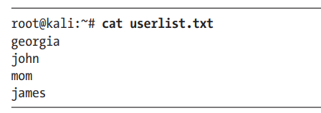
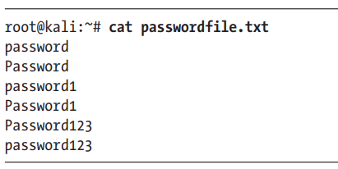
Wordlists
User list
Password lists
Internet
https://packetstormsecurity.com/Crackers/wordlists/
https://www.openwall.com/wordlists/
Kali
/usr/share/wordlists

Slide 6
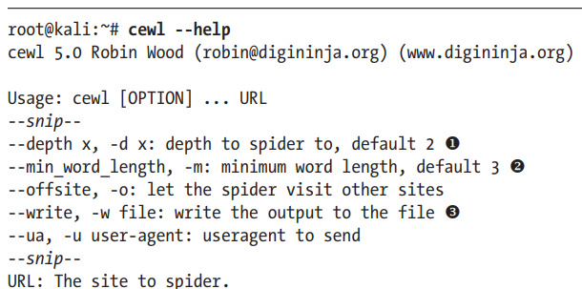
ceWL tool
To make educated guesses based on information you gather while performing reconnaissance, a tool like the ceWL custom wordlist generator will search a company website for words to add to your wordlist
(1) -d (depth) option to specify how many links ceWL should follow on the target website.
(2) minimum word length
(3) output ceWL’s results to a file

Slide 7
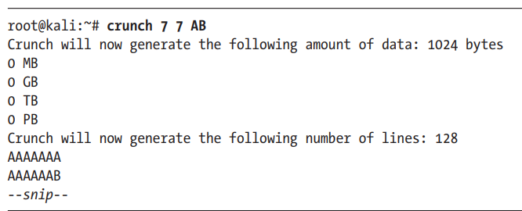
Crunch tool
Another method for creating wordlists is producing a list of every possible combination of a given set of characters, or a list of every combination of characters for a specified number of characters.
min
max

Slide 8
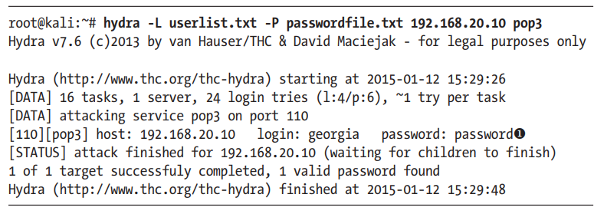
Hydra tool
If you have a set of credentials that you’d like to try against a running service that requires a login, you can input them manually one by one or use a tool, e.g. Hydra to automate the process

Slide 9
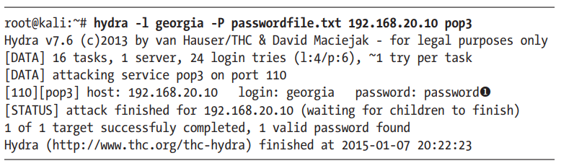

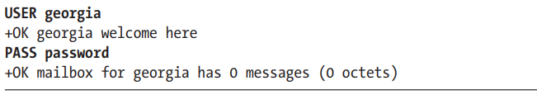
Hydra tool

Slide 10
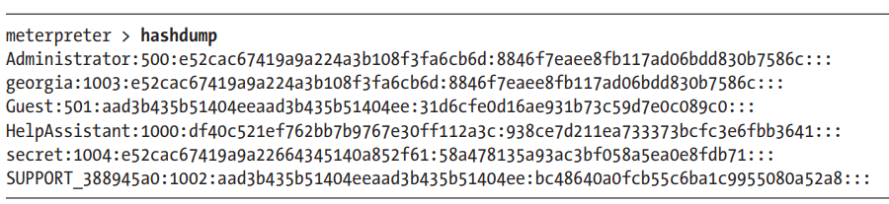
Offline Password Attacks
Method: getting a copy of the password hashes and attempt to reverse them back to plaintext password
    If the two hashes are the same, we’ve found the correct password.
We gained access to some password hashes on the Linux and Windows XP targets
    In Chapter 8, we can use the hashdump Meterpreter command to print the hashed Windows passwords
On the Linux target, the Vsftpd smiley-face backdoor gave us root privileges, and thus we can access to the file /etc/shadow, which stores Linux password hashes.

Slide 11
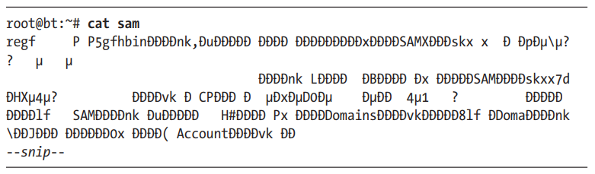
Though we were able to use Meterpreter to dump the password hashes from XP (as shown previously), sometimes you’ll be able to get only the SAM file.
… but SAM file is obfuscated by encrypting the password hashes inside the SAM file with 128-bit Rivest Cipher 4 (RC4)

Slide 12
Security Accounts Manager (SAM)
SAM is a vital component of how Windows stores passwords locally on the computer system. Storage of user and account information in the SAM database provides system users the ability to authenticate to the local system if an account has been created for them. Passwords stored in the SAM database are stored in either LAN Manager (LM) hash or NT LAN Manager (NTLM) format depending on the policies implemented and enforced for password storage.
During normal operation of a Windows system, the SAM database cannot be copied due to restrictions enforced by the operating system kernel.
The SAM database is stored in two places within Windows: %systemroot%\system32\config\sam is the location of the main storage for passwords and %systemroot%\repair\sam._ is a backup of the main file in the event that recovery is required for a repair process.

Slide 13
LM vs. NTLM Hashing Algorithms
The LAN Manager hash was one of the first password hashing algorithms to be used by Windows operating systems, and the only version to be supported up until the advent of NTLM used in Windows 2000, XP, Vista, and 7.
These newer operating systems still support the use of LM hashes for backwards compatibility purposes. However, it is disabled by default for Windows Vista and Windows 7
In earlier versions of Windows, the LM hash is typically stored and transmitted by default. However, in Windows Vista and versions above, the LM hash is not stored by default, nor is it used by default during network authentication. Instead, the newer versions use the NTLMv2 hash as the default authentication method.

Slide 14
LM Hash Example
If LM hashes are enabled on your system (Win XP and lower), a hash dump will look like:
If LM hashes are disabled on your system (Win Vista, 7, 8+), a hash dump will look like:
1
2
3
4
Administrator:500:01FC5A6BE7BC6929AAD3B435B51404EE:0CB6948805F797BF2A82807973B89537:::
Administrator:500:NO PASSWORD*********************:0CB6948805F797BF2A82807973B89537:::
(1) First filed: the username
(2) Second field: the SID (Security IDentifier) for that username
(3) Third field: the LM hash
(4) Forth field: the NTLM hash

Slide 15
LM Hash Algorithm
When a user creates a new password, this password is converted to all uppercase
then it's padded out to 14 characters
The password is then split into two 7-byte chunks
The two chunks then will be used as a key in a Data Encryption Standard (DES) encryption to encrypt a fixed value
The values of the two DES operations are concatenated and the result is stored as the LM hash
LM hash weaknesses
The password length is limited to 14 characters, broken up into two independent 7-byte chunks.
the password is case-insensitive which decreases the key space available for the users to choose their passwords from

Slide 16
NTLM Hash
NTLM was accepted as the new authentication method of choice and implemented with Windows NT 4. It uses MD4 (NTLM v1) and MD5 (NTLM v2) hashing algorithm to create the hash based upon a series of mathematical calculations.
    MD4/MD5 is considered to be significantly stronger than DES
NTLM Algorithm
It takes the password, hashes it using the MD4 algorithm
It does not break up the password into chunks
the password is case-sensitive
can support very long passwords (127 characters)

Slide 17
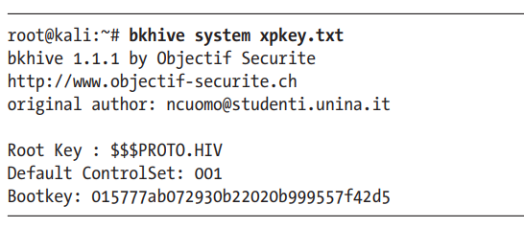
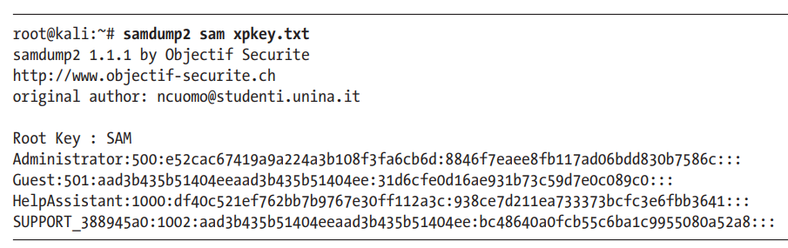
The encryption key is called the bootkey stored in the Windows SYSTEM file (C:\Windows\repair directory).
Once we have the bootkey, we can use Samdump2 to retrieve the password hashes from the SAM file

Slide 18
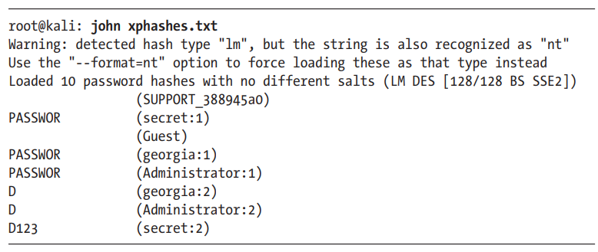
Cracking passwords
John the Ripper
    One of the more popular tools for cracking passwords is John the Ripper.
    The default mode for John the Ripper is brute forcing

Slide 19
Linux password hashes
/etc/shadow
    contains the hashed password and the password expiry data.
/etc/password
    contains the users' public information (UID, full name, home directory)

Slide 20
Dumping Plaintext Passwords from Memory with WCE
If we have access to a Windows system, in some cases we can pull plaintext passwords directly from memory.
    One tool with this functionality is the Windows Credential Editor (WCE)

